Slide 1
1 – The essence and basic concepts of marketing
2 – Objectives, activities and principles of marketing
3 – Marketing mix and marketing quality
4 – Types and forms of marketing
5 – Evolution of the marketing concept of management
Topic 12 Marketing Management

Slide 2
Question 1 - The essence and basic concepts of marketing

Slide 3

Concept and essence of marketing
“What a firm thinks about its products is not the most important thing, especially for the future of the business or its success. What the consumer thinks about his purchase, what he sees its value - that's what is of decisive importance, determines the essence of the business, its focus and chances of success «
Peter Drucker
the father of modern management

Slide 4
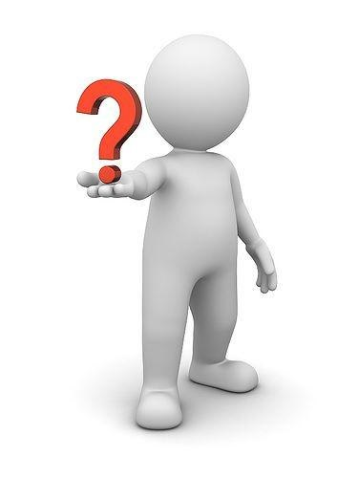
Concept and essence of marketing
«MARKETING» – from English marketing (market):
«market engagement»
«market studies»
«market making»
How the term "marketing" is commonly used in 3 different meanings:
1. As part of the management process: integrated systemic market activities focused on the customer
2. As a science: the science of behavior, which seeks to explain the relationships that arise in the exchange process
3. As ideology (philosophy) of business: business culture
it is based on a simple initial idea: to produce what the buyer wants (requires) and what, in general, will be able to satisfy his needs, requirements and demands, and at the price that he is willing to pay.

Slide 5
Marketing
In a broad sense | In a narrow sense
it is a socio-managerial process through which individuals and groups of people, through the creation of products and their exchange, get what they need. | management system for the production and marketing activities of an organization aimed at obtaining an acceptable amount of profit through accounting and active influence on market conditions.
Definitions of marketing
Marketing is a social process aimed at meeting the needs and desires of individuals and organizations by creating a free competitive exchange of goods and services that create value for the buyer. Jean-Jacques Lambin | Marketing is a type of human activity aimed at meeting the needs and requirements of individuals and organizations through exchange. Philip Kotler

Slide 6
Main Marketing Categories
Marketing as a socio-economic process is based on the following key (basic) concepts (marketing categories):
Need
Require-ment
Desire
Demand (Request)
Product
Exchange
Deal
Market
Marketing
Need - a shortcoming, shortage, absence something.
A requirement is a conscious need - a need for something that requires satisfaction. When a person is unable to satisfy some need, he either replaces it or reduces the level of his requests. The concept of needs underlies the theories of motivation (Z. Freud, A. Maslow, etc.), including those determining consumer behavior in the market. It is often said that the main task of marketing is to find a need and satisfy it.
Desire is a need that has taken a specific form in accordance with the cultural level and personality of the individual. It is sometimes called a specific need. In different regions and countries, general needs are transformed into a wide variety of desires, determined by cultural, historical, geographical and other factors.

Slide 7

Basic Marketing Concepts
Demand (request) - desire, specific need, supported by purchasing power. Given the resource possibilities, people satisfy their needs and desires by purchasing products that bring them the greatest benefit and satisfaction.
A product is anything that can be offered on the market for purchase, use or consumption in order to meet specific needs.
It can be:
Physical items
Services
Works
People
Places
Events
Organizations
Activities
Ideas

Slide 8

Basic Marketing Concepts
Exchange is the act of receiving a desired product from someone by offering him something in return.
In order for the exchange to take place, compliance is required 5
potential conditions:
at least 2 parties
each party must have something of value from the other party's point of view
each party must be able to negotiate and deliver
each party is free to accept or reject the offer the other party
each party believes it is appropriate or desirable to deal with the other party
A deal is a trade operation between two parties, which presupposes the fulfillment of the following conditions:
availability of at least two products of interest for mutual exchange
availability of agreed conditions, time and place of its execution

Slide 9
Basic Marketing Concepts
The market is a collection of existing / potential sellers and buyers of some products; it is a system of relationships within which transactions are made.
It is on the market that the product produced and the labor expended on it prove their social significance, acquire recognition from consumers (consumer value - exchange value).
In modern society, the market does not necessarily have a physical location. To demonstrate a product, advertise it, and receive orders, modern means of communication are widely used without physical contact with customers.
In marketing, a narrower understanding of the market is often used - as a set of consumers for a particular product; they say - the market for metal, grain, etc. Market segmentation is often carried out on the basis of this principle.
Marketing - management of demand, market activities of a modern organization.

Slide 10
Question 2 - Objectives, activities and principles of marketing

Slide 11
From the point of view of social significance, four alternative marketing goals can be formulated:
It is believed that maximizing consumption maximizes production, employment, and therefore the welfare of society.
Maximizing the quality of life is one of the alternative public goals of marketing, according to which marketing should not only ensure the quantity, quality, variety and availability of goods at affordable prices, but also the quality of the cultural and physical environment of people.
marketing objectives
Maximizing consumption
Maximizing customer satisfaction
Maximizing consumer choice
Maximizing the quality of life of the consumer
This characterizes marketing goals from different perspectives. Obviously, it is not possible to satisfy all these goals equally.
The goal of maximizing the degree of customer satisfaction is based on the fact that it is more important not to simply increase consumption, but to achieve an increase in the degree of customer satisfaction.
In order to maximize consumer choice, it is necessary to provide such a variety of products that consumers can find products that exactly suit their tastes.

Slide 12
Main types of marketing activities
identification of markets within the scope of the firm's activities
determining real (potential) market demand
categorizing buyers according to their requests
selection of consumer categories whose needs and demands the firm can satisfy better than its competitors
development of the proposal of the company satisfying the request
(Marketing complex: product + price + distribution + promotion)
ensuring availability of the firm's offer
informing potential and real consumers about the offer and where the offer can be purchased
Continuous decision-making on what needs to be added, removed, modified and improved to meet changing needs and circumstances

Slide 13
The principles of marketing are the basic foundations of marketing activities arising from the laws and patterns of development of the market system and reflecting its essence:
Knowledge of the market, a comprehensive study of needs based on constant market research, structure and dynamics of demand, tastes and desires of consumers when making management decisions
Creation of conditions for maximum adaptation of production to market requirements, to the structure of demand, proceeding not from immediate profit, but from a long-term perspective
Impact on the market, on the buyer using all available means (using all elements of the marketing mix)
The focus of each participant to achieve the final result
An integrated approach to linking goals with the resources and capabilities of the firm
Development of an effective product policy, creation and production of certain goods
Constant search for methods to improve the efficiency of using the company's resources, encouraging the creative initiative of employees, creating a corporate culture of marketing orientation
Finding ways to adapt the company to constantly changing environmental conditions in order to maximize customer satisfaction

Slide 14
Question 3 - Marketing mix and marketing quality

Slide 15
Marketing mix
The classic marketing mix includes 4 elements:
Marketing mix
Product
Price
Place
Promotion
The concept was originally proposed in the 1940s. Neil Borden, and in 1960 the "4p" concept was developed by Jerome McCarthy.
Marketing formula = Consumer + Marketing mix

Slide 16
Marketing quality
In the early 90s. in the twentieth century, there comes a complete understanding that one of the keys to success in business is the quality of marketing.
One of the interesting interpretations of the concept of "marketing quality" was given by the German professor Klaus Brockhoff. In his opinion, it is expressed in the following aspects:
Philosophical aspect
Behavioral aspect
Information aspect
Operating principle aspect
Differentiation aspect
Organizational aspect
Social aspect
customer satisfaction, focus on continuous innovation, priority of long-term thinking in relation to short-term
firm focus on consumer health and the environment, safety
constant concern for the image of the company and its products, stimulating sensual, not rational perception of the product
decentralization and flexibility of management instead of centralization and bureaucratization; creation of profit centers
market research orientation, value-based creative market shaping, evidence-based concept development
using customer behavioural stereotypes as driving factors when affecting a particular consumer group
complex systemic marketing instead of one-sided highlighting of its individual functions

Slide 17
Question 4 - Types and forms of marketing

Slide 18
Types of marketing
MM
Market
Mass / Undifferentiated - the firm directs its offer to the market as a whole, works with mass demand (standardization strategy - taking into account the similarity in needs).
MМ1
Segment1
Differentiated - the company's offer is aimed at the most profitable segments, for each of which its own marketing complex is developed (its own "basket of benefits" is selected) / customization strategy - taking into account differences in needs.
MМ2
Segment2
MМ3
Segment3
MМ
Сегмент1
Segment1
Concentrated - the firm focuses on one segment (focuses on one segment with unique / unmet needs).
Сегмент2
Segment2
Segment3
Сегмент3

Slide 19
Forms of marketing
By the purpose of the exchange
Commercial
Noncommercial
By the field of exchange
Internal
international
By scope of application
By type of activity
Local
Export
Consumer
Industrial
Investment
Services
Organization marketing
Personal Marketing / Egomarketing
Territorial
Ideas / Social Marketing
Celebrity Marketing
Recreation areas
Political Marketing
Regional
National
Passive
Active
Multinational
Global
Professional Marketing
Housing
Business zones
Investment in land property
Territorial:
-Country
-Regional
-Municipal

Slide 20
Individual Marketing (Personal Marketing) - activities undertaken to create, maintain or change the attitude or behavior of the public towards specific individuals. Many people use personal marketing in order to increase their popularity and expand their business: these are politicians, artists, doctors, athletes, lawyers, businessmen, etc. The personal marketing process is similar to the marketing process for physical products and services. It also starts with market research, identifying market segments and needs. Next, product development begins, determining to what extent the qualities of a person and its “design” and “packaging” correspond to the needs and to what extent it is necessary to transform this personality so that it meets these needs to a greater extent.
Organization marketing is an activity undertaken with the aim of creating and maintaining a favorable image of an organization. This is traditionally the responsibility of public relations units. Opinion organization is essentially marketing management, shifted from the product level to the entire organization level. This also includes the so-called political marketing carried out by the authorities, political parties.
Location marketing refers to activities undertaken to create, maintain, or change customer relationships or behavior in relation to specific locations. Here, first of all, it is necessary to highlight: marketing of zones of economic activity (location of factories, shops, offices, etc.), marketing of recreation places; marketing of housing and marketing of investments in land property. If the state is the owner of the land, then this type of marketing is referred to as macromarketing.
Idea marketing is usually interpreted in relation to social ideas such as reducing smoking, drinking, stopping drug use, protecting the environment, etc. (in a broad sense, any marketing is marketing of certain ideas).

Slide 21
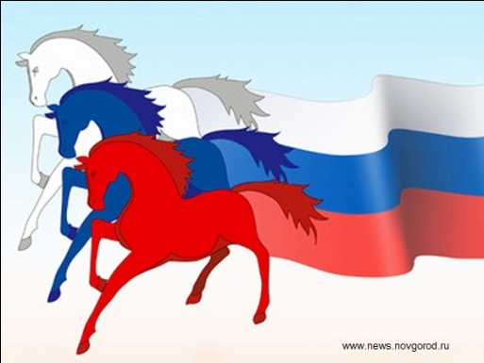
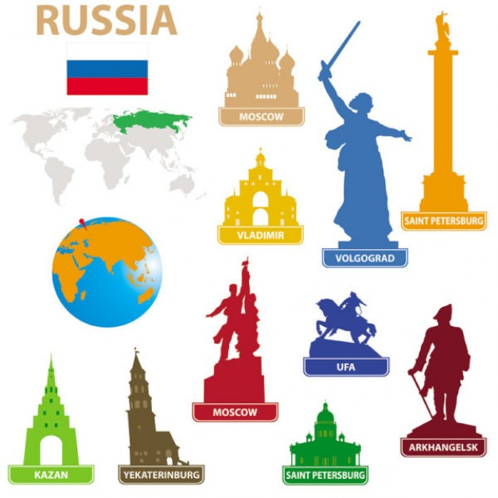
Marketing and its technologies today are increasingly used at all levels of the hierarchy of management of the economic and social system:
At the micro level - a firm or organization, an individual
At the meso level - at the level of industries
At the macro level - the system as a whole (state, regions, etc.)
Macromarketing
The concept originated in the West during the 1960s - late 1980s.
The subject of macro marketing is the relationship between marketing activities and society.
Its emergence as an independent direction is directly related to the increased interest of society in the role that business plays in it.
The problems of macromarketing, in contrast to the problems of micromarketing, should be considered from the point of view of the interests of society. In this context, macromarketing is considered as an aggregated element of the economic system, the results of which should be evaluated on an equal basis with the results of other elements of the economy, such as income distribution (taxation), wealth, productivity.
Moreover, marketing, along with other elements of the economy, should be responsible for achieving social goals.
Here, first of all, we can talk about marketing of the country as a whole.

Slide 22
Macromarketing
Using the marketing approach in government bodies when solving the following tasks:
In relation to the country, marketing is aimed at increasing (maintaining) its attractiveness for other countries, their economic entities, other social institutions and the population, prestige in international organizations.
Marketing of the country, of course, does not aim at specific sales acts and is not for profit, although there are a lot of important indirect economic results of such marketing. These are the effects of the implementation of geophysical, financial, technical, technological and personnel resources (use of internal resources outside the territory and attraction of external resources), growth in volumes and intensification of foreign economic activity, the results of participation in international projects, etc.
Macromarketing application directions:
covering budget deficit
efficient use of land resources
state support for small business
1. Identification of individual regions and organizations that are in greatest need of state support and whose accelerated development will ensure structural restructuring and the solution of other socio-economic problems in Russia.
2. Regulation of supply and demand for certain types of goods and services, ensuring the parity of prices for agricultural and industrial products through reasonable tax and price policies, export-import quotas and duties, etc.
3. Competent formulation of government orders for military equipment, construction projects, agricultural products, etc.
4. Determination of priorities for individual target programs at the state level.

Slide 23
Territorial marketing
Recently, in the development of ideas for marketing a place, marketing of entire regions, cities and other settlements is increasingly used, aimed at attracting capital and ensuring sustainable development of the region. This type of marketing is called territorial (regional / municipal).
Territorial marketing is marketing in the interests of the territory, its internal subjects, as well as external subjects in whose attention the territory is interested.
It is carried out with the aim of creating, maintaining or changing the opinions, intentions and / or behavior of subjects external to the given territory.
It is aimed at creating and maintaining:
- attractiveness, prestige of the territory as a whole;
- attractiveness concentrated on the territory of natural, logistical, financial, labor, organizational, social and other resources, and also opportunities for the implementation and reproduction of such resources.
In recent decades, interesting experience of regions and cities of different countries began to accumulate in using the potential of marketing in order to increase the tourist and commercial attractiveness of regions.
Speaking of territorial marketing, attention is focused on the motives and goals of entrepreneurs, on the benefits that they seek to get in a new region where they are transferring their activity, as well as to reduce the difficulties that may hinder their aspiration to this territory.

Slide 24
Types of marketing
are allocated depending on the nature of the demand in the market
Philip Kotler identified 8 types of demand, which correspond to different types of marketing activities:
The nature of market demand | Description of demand | Marketing Type | Marketing Tasks
Negative | The goods are not liked by customers (vaccinations, dental services, surgical operations) | Conversion | Analysis of the reasons for the negative attitude to the product and creation of a program for its change
Absent | The market is indifferent to the product | Stimulating (creative) | Link product benefits to natural needs and human interests
Hidden (latent) | There is a need, but the existing goods do not satisfy it | Developing | Evaluate the potential market size and create an appropriate offer
Falling | As the market becomes saturated, the demand for goods decreases | Remarketing | Analyze the reasons for the deterioration of market conditions and creatively rethink the approach to the supply of goods (rebranding, repositioning)
Irregular | Seasonal, daily, weekly and even hourly fluctuations | Stabilizing (synchromarketing) | Find ways to smooth out fluctuations in demand distribution over time (off-peak pricing)
Full | The company is satisfied with its turnover | Supporting | Support despite changing consumer preferences and competition; focus on quality and service
Excessive | For example, resorts that are crowded in the summer | Demarketing | To bring down demand through higher prices, weakening of incentives, reduction of service; but not to eliminate it, but to reduce it!
Irrational | Products harmful to health | Counteracting | Force to abandon their habits through frightening information, high prices, limited availability of goods

Slide 25
Question 5 - Evolution of the marketing concept of management

Slide 26
Evolution of the marketing concept of management
In developed countries, the history of the development of marketing as a regulatory system is closely related to the stages of market development and benchmarks in the market activities of firms.
Based on the historical stages of the development of classical marketing, there are several conceptual approaches to its organization:
Production concept
Before the early 1930s
Sales concept
Before the early 1950s
Product concept
Before the early 1970s
Consumer concept
Societal Marketing Concept
1950s to late 1970s
Since the 1980s

Slide 27
 | production | sales concept | product concept
The essence of the concept | Any product will be in demand if it is affordable and widely available on the market. | Any product can be sold if efforts are made to do so. | Any product can be sold on the market if it is of good quality
Features of the concept | The activities of the company are focused only on the possibilities of production (not on the needs of society) | Focusing on intensifying marketing efforts (which required significantly lower costs) | The efforts of companies are aimed at product differentiation (improvement of product characteristics), for which the companies have already accumulated sufficient resources
Producer's goals | Increase in sales | Production of goods followed by sophisticated marketing | Improving the quality of goods, characteristics of goods that are valuable to the consumer
Way to achieve the goal | Cost reduction - achieved by increasing production and labor productivity | Aggressive methods of coercion to a one-time purchase (psychological pressure, material interest - gifts, discounts), methods of targeting buyers for long-term purchases (discounts for regular customers) | Achieved by technical developments (innovations), allowing to distinguish the product from competitors in terms of its quality characteristics
Modern conditions of use | Mass Demand Products, High Capacity Market | Goods of passive demand (the buyer does not feel the need for a product until he learns about its merits, an excess of goods in the absence of natural demand) | Can be applied to any type of market
Disadvantages | The narrowness of the product range against the background of growth in labor productivity and production volumes leads to saturation and oversaturation of the market | The emergence of "immunity" of buyers to various methods of intensive sales, saturation of the market with a narrow product range, slowdown or termination of the growth of companies | The high price of the product on the market (the manufacturer reimburses the development costs of the product). In addition, the manufacturer is unable to adequately assess the threat from substitute products (Marketing Myopia)

Slide 28
 | Consumer concept | Societal Marketing Concept
The essence of the concept | The product will be sold on the market if its production is preceded by a study of the market situation and needs | A quality product will be in demand if it meets non-economic social needs (environmental protection, product safety, etc.)
Features of the concept | The attention of the company's management is aimed at meeting the real needs of the market | During the competition, companies focus on the usefulness/safety of their products for societies
Producer's goals | Striving to follow the structure of consumer demand in its activities | During the competition, companies focus on the usefulness/safety of their products for societies
Way to achieve the goal | Firms spend significant resources on studying demand and consumer preferences and strive to produce goods in demand in the market. | During the competition, companies focus on the usefulness/safety of their products for societies
Modern conditions of use | Can be applied to any type of market | Economically developed markets that have passed the stage of mass orientation on marketing
Disadvantages | The desire of companies to focus on the immediate needs of the individual, which ultimately leads to a conflict with the ideas of the long-term well-being of society | Lack of solutions to a number of technological problems, such as the high price of goods

